Slide 1
Big Data – Welcome Week 1 – 1/26
Professor Arturo Castellanos, PhD
Assistant Professor – William & Mary
Big Data - MSBA

Slide 2

Characteristics of Cloud Computing
On-demand self service:
Cloud computing resources can be provisioned on-demand by the users, without requiring interactions with the cloud service provider. The process of provisioning resources is automated.
Broad network access:
Cloud computing resources can be accessed over the network using standard access mechanisms that provide platform-independent access through the use of heterogeneous client platforms such as workstations, laptops, tablets and smartphones.

Slide 3
Cloud Service Models
Software as a Service (SaaS)
Applications, management and user interfaces provided over a network
Platform as a Service (PaaS)
Application development frameworks, operating systems and deployment frameworks
Infrastructure as a Service (IaaS)
Virtual computing, storage and network resource that can be provisioned on demand

Slide 4
Software-as-a-Service (SaaS)
Software/Interface
SaaS provides the users a software application or the user interface to the application itself.
Outsourced Management
The cloud service provider manages the underlying cloud infrastructure including servers, network, operating systems, storage and application software, and the user is unaware of the underlying architecture of the cloud.
Thin client interfaces
Applications are provided to the user through a thin client interface (e.g., a browser). SaaS applications are platform independent and can be accessed from various client devices such as workstations, laptop, tablets and smartphones, running different operating systems.
Ubiquitous Access
Since the cloud service provider manages both the application and data, the users are able to access the applications from anywhere.

Slide 5
Software-as-a-Service (SaaS)
SaaS
Benefits
- Lower costs
- No infrastructure required
- Seamless upgrades
- Guaranteed performance
- Automated backups
- Easy data recovery
- Secure
- High adoption
- On-the move access
Characteristics
- Multi-tenancy
- On-demand software
- Open integration protocols
- Social network integration
Adoption
- Individual users: High - Small & medium enterprises: High - Large organizations: High
- Government: Medium
Examples
- Google Apps
- Salesforce.com
- Facebook
- Zoho
- Dropbox
- Taleo
- Microsoft Office 365
- Linkedin
- Slideshare
- CareCloud

Slide 6
Infrastructure-as-a-Service (IaaS)
Resource Provisioning
Provides the users the capability to provision computing and storage resources.
Virtual Machines
These resources are provided to the users as virtual machine instances and virtual storage. Users can start, stop, conﬁgure and manage the virtual machine instances and virtual storage.
Provider Managers Infrastructure:
The cloud service provider manages the underlying infrastructure.
Pay-per-use/Pay-as-you-go:
Virtual resources provisioned by the users are billed based on a pay-per-use/pay-as-you-go paradigm.

Slide 7
Cloud Deployment Models
Public Cloud
Available for public use or a large industry group
Private Cloud
Operated for exclusive use of a single organization
Community Cloud
Available for shared use of several organizations supporting a speciﬁc community
Hybrid Cloud
Combines multiple clouds (public and private) that remain unique but bound together to offer application and data portability

Slide 8
Cloud Service Examples
IaaS:
Amazon EC2
Google Compute Engine
Windows Azure VMs
PaaS:
Google App Engine
SaaS:
Salesforce

Slide 9
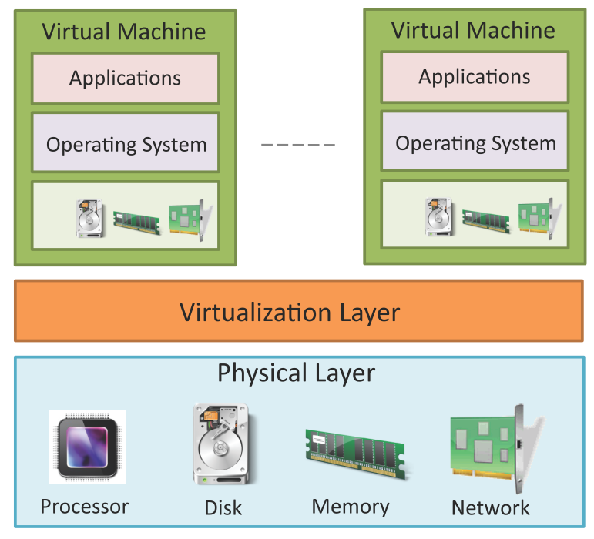
Virtualization
Virtualization refers to the partitioning the resources of a physical system (such as computing, storage, network and memory) into multiple virtual resources.
Key enabling technology of cloud computing that allow pooling of resources.
In cloud computing, resources are pooled to serve multiple users using multi-tenancy.

Slide 10
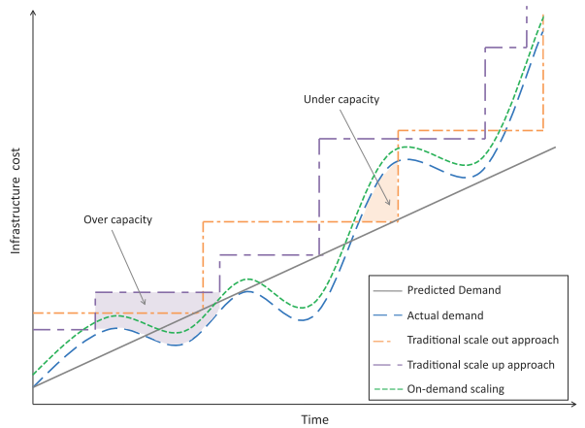
Scalability & Elasticity
Multi-tier applications such as e-Commerce, social networking, business-to-business, etc. can experience rapid changes in their traffic.
Capacity planning involves determining the right sizing of each tier of the deployment of an application in terms of the number of resources and the capacity of each resource.
Capacity planning may be for computing, storage, memory or network resources.

Slide 11
Scaling Approaches
Vertical Scaling/Scaling up:
Involves upgrading the hardware resources (adding additional computing, memory, storage or network resources).
Horizontal Scaling/Scaling out
Involves addition of more resources of the same type.

Slide 12
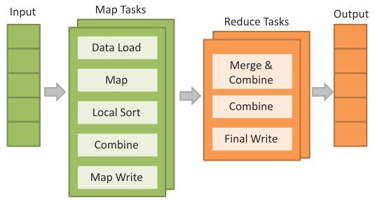
Example: MapReduce
MapReduce is a parallel data processing model for processing and analysis of massive scale data.
MapReduce phases:
Map Phase: In the Map phase, data is read from a distributed file system, partitioned among a set of computing nodes in the cluster, and sent to the nodes as a set of key-value pairs.
The Map tasks process the input records independently of each other and produce intermediate results as key-value pairs.
The intermediate results are stored on the local disk of the node running the Map task.
Reduce Phase: When all the Map tasks are completed, the Reduce phase begins in which the intermediate data with the same key is aggregated.

Slide 13
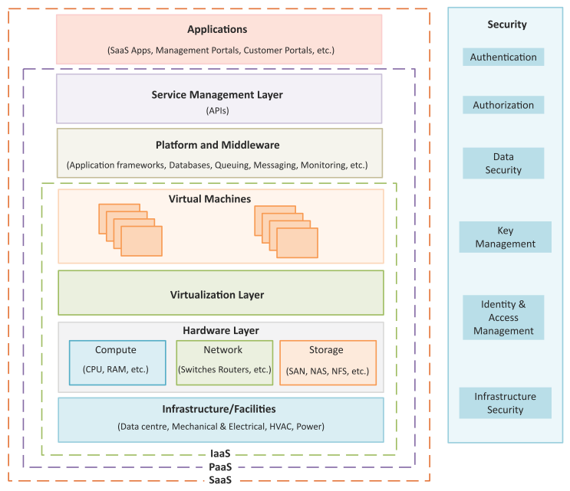
Cloud Reference Model
Infrastructure & Facilities Layer
Includes the physical infrastructure such as datacenter facilities, electrical and mechanical equipment, etc.
Hardware Layer
Includes physical compute, network and storage hardware.
Virtualization Layer
Partitions the physical hardware resources into multiple virtual resources that enabling pooling of resources.
Platform & Middleware Layer
Builds upon the IaaS layers below and provides standardized stacks of services such as database service, queuing service, application frameworks and run-time environments, messaging services, monitoring services, analytics services, etc.
Service Management Layer
Provides APIs for requesting, managing and monitoring cloud resources.
Applications Layer
Includes SaaS applications such as Email, cloud storage application, productivity applications, management portals, customer self-service portals, etc.

Slide 14

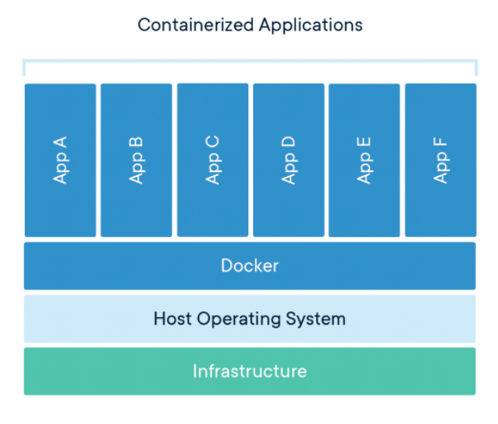
Docker Containers
A container is a standard unit of software that packages up code and all its dependencies so the application runs quickly and reliably from one computing environment to another.
A Docker container image is a lightweight, standalone, executable package of software that includes everything needed to run an application: code, runtime, system tools, system libraries and settings.
Container images become containers at runtime and in the case of Docker containers - images become containers when they run on Docker Engine. Available for both Linux and Windows-based applications, containerized software will always run the same, regardless of the infrastructure.
Source: https://www.docker.com/resources/what-container

Slide 15
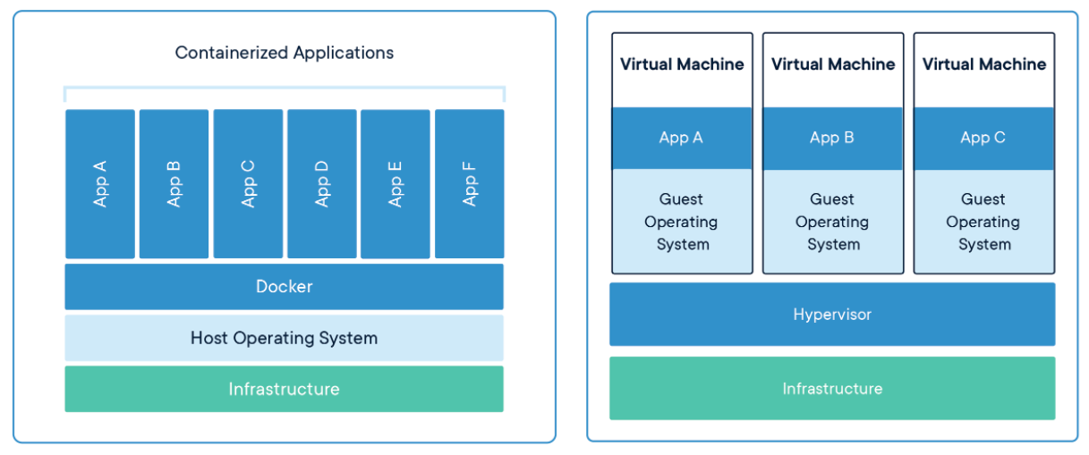
Comparing Containers to VMs
Containers are an abstraction at the app layer that packages code and dependencies together.
Multiple containers can run on the same machine and share the OS kernel with other containers, each running as isolated processes in user space.
Containers take up less space than VMs (container images are typically tens of MBs in size), can handle more applications and require fewer VMs and Operating systems.
Virtual machines (VMs) are an abstraction of physical hardware turning one server into many servers. The hypervisor allows multiple VMs to run on a single machine. Each VM includes a full copy of an operating system, the application, necessary binaries and libraries - taking up tens of GBs. VMs can also be slow to boot.
Source: https://www.docker.com/resources/what-container

Slide 16
Compute Services – Amazon EC2
Amazon Elastic Compute Cloud (EC2) is a compute service provided by Amazon.
Launching EC2 Instances
To launch a new instance click on the launch instance button. Instances can be launched with a variety of operating systems.
Instance Sizes
When you launch an instance you specify the instance type (micro, small, medium, large, extra-large, etc.), the number of instances to launch based on the selected AMI and availability zones for the instances.
Key-pairs
When launching a new instance, the user selects a key-pair from existing keypairs or creates a new keypair for the instance. Keypairs are used to securely connect to an instance after it launches.
Security Groups
The security groups to be associated with the instance can be selected from the instance launch wizard. Security groups are used to open or block a specific network port for the launched instances.

Slide 17
Storage Services – Amazon S3
Amazon Simple Storage Service(S3) is an online cloud-based data storage infrastructure for storing and retrieving any amount of data.
S3 provides highly reliable, scalable, fast, fully redundant and affordable storage infrastructure.
Buckets
Data stored on S3 is organized in the form of buckets. You must create a bucket before you can store data on S3.
Uploading Files to Buckets
S3 console provides simple wizards for creating a new bucket and uploading files.
You can upload any kind of file to S3.
While uploading a file, you can specify the redundancy and encryption options and access permissions.

Slide 18
Compute Services – Amazon EC2
Amazon Elastic Compute Cloud (EC2) is a compute service provided by Amazon.
Launching EC2 Instances
To launch a new instance click on the launch instance button. Instances can be launched with a variety of operating systems.
Instance Sizes
When you launch an instance you specify the instance type (micro, small, medium, large, extra-large, etc.), the number of instances to launch based on the selected AMI and availability zones for the instances.
Key-pairs
When launching a new instance, the user selects a key-pair from existing keypairs or creates a new keypair for the instance. Keypairs are used to securely connect to an instance after it launches.
Security Groups
The security groups to be associated with the instance can be selected from the instance launch wizard. Security groups are used to open or block a specific network port for the launched instances.

Slide 19
Amazon EMR (Elastic Map Reduce)
Cloud-based analytics services allow analyzing massive data sets stored in the cloud either in cloud storages or in cloud databases using programming models such as MapReduce.
Amazon Elastic MapReduce
Amazon Elastic MapReduce is the MapReduce service from Amazon based the Hadoop framework running on Amazon EC2 and S3
EMR supports various job types such as:
Custom JAR
Hive program
Streaming job
Pig programs
Hbase

Slide 20
Compute Services – Amazon EC2
Amazon Elastic Compute Cloud (EC2) is a compute service provided by Amazon.
Launching EC2 Instances
To launch a new instance click on the launch instance button. Instances can be launched with a variety of operating systems.
Instance Sizes
When you launch an instance you specify the instance type (micro, small, medium, large, extra-large, etc.), the number of instances to launch based on the selected AMI and availability zones for the instances.
Key-pairs
When launching a new instance, the user selects a key-pair from existing keypairs or creates a new keypair for the instance. Keypairs are used to securely connect to an instance after it launches.
Security Groups
The security groups to be associated with the instance can be selected from the instance launch wizard. Security groups are used to open or block a specific network port for the launched instances.

Slide 21
Compute Services – Amazon EC2
Amazon Elastic Compute Cloud (EC2) is a compute service provided by Amazon.
Launching EC2 Instances
To launch a new instance click on the launch instance button. Instances can be launched with a variety of operating systems.
Instance Sizes
When you launch an instance you specify the instance type (micro, small, medium, large, extra-large, etc.), the number of instances to launch based on the selected AMI and availability zones for the instances.
Key-pairs
When launching a new instance, the user selects a key-pair from existing keypairs or creates a new keypair for the instance. Keypairs are used to securely connect to an instance after it launches.
Security Groups
The security groups to be associated with the instance can be selected from the instance launch wizard. Security groups are used to open or block a specific network port for the launched instances.

Slide 22
Compute Services – Amazon EC2
Amazon Elastic Compute Cloud (EC2) is a compute service provided by Amazon.
Launching EC2 Instances
To launch a new instance click on the launch instance button. Instances can be launched with a variety of operating systems.
Instance Sizes
When you launch an instance you specify the instance type (micro, small, medium, large, extra-large, etc.), the number of instances to launch based on the selected AMI and availability zones for the instances.
Key-pairs
When launching a new instance, the user selects a key-pair from existing keypairs or creates a new keypair for the instance. Keypairs are used to securely connect to an instance after it launches.
Security Groups
The security groups to be associated with the instance can be selected from the instance launch wizard. Security groups are used to open or block a specific network port for the launched instances.

Slide 23
Compute Services – Amazon EC2
Amazon Elastic Compute Cloud (EC2) is a compute service provided by Amazon.
Launching EC2 Instances
To launch a new instance click on the launch instance button. Instances can be launched with a variety of operating systems.
Instance Sizes
When you launch an instance you specify the instance type (micro, small, medium, large, extra-large, etc.), the number of instances to launch based on the selected AMI and availability zones for the instances.
Key-pairs
When launching a new instance, the user selects a key-pair from existing keypairs or creates a new keypair for the instance. Keypairs are used to securely connect to an instance after it launches.
Security Groups
The security groups to be associated with the instance can be selected from the instance launch wizard. Security groups are used to open or block a specific network port for the launched instances.

Slide 24
Compute Services – Amazon EC2
Amazon Elastic Compute Cloud (EC2) is a compute service provided by Amazon.
Launching EC2 Instances
To launch a new instance click on the launch instance button. Instances can be launched with a variety of operating systems.
Instance Sizes
When you launch an instance you specify the instance type (micro, small, medium, large, extra-large, etc.), the number of instances to launch based on the selected AMI and availability zones for the instances.
Key-pairs
When launching a new instance, the user selects a key-pair from existing keypairs or creates a new keypair for the instance. Keypairs are used to securely connect to an instance after it launches.
Security Groups
The security groups to be associated with the instance can be selected from the instance launch wizard. Security groups are used to open or block a specific network port for the launched instances.

